Slide 1
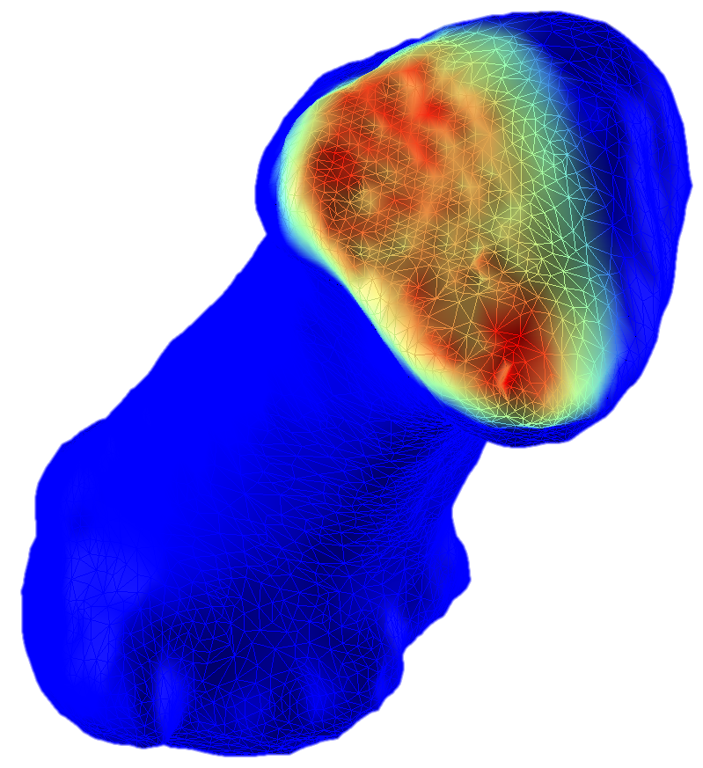
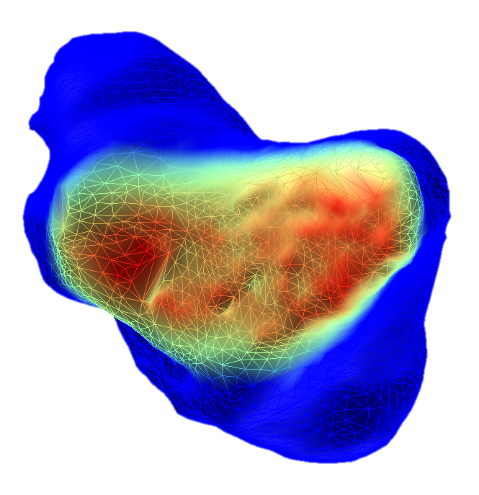
JOINT PRESSURE ASSESSMENT
Academic
Measuring Intra-Articular Joint Pressure via Medical Imaging
2015

Slide 2
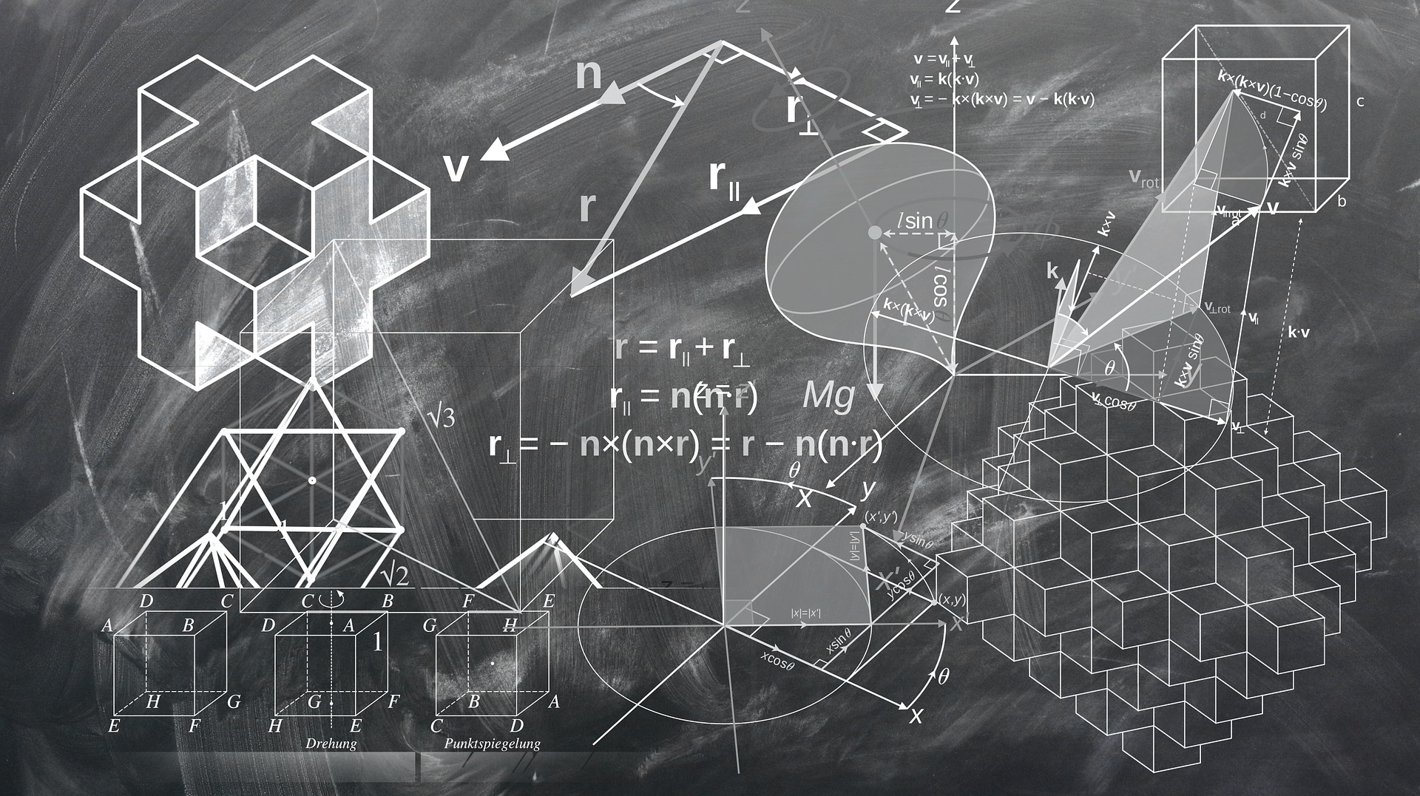

3D TRANSFORMATIONS TOOLBOX
Algorithm Development
Designed algorithms to assess and generate transformations on 3D objects
2015

Slide 3
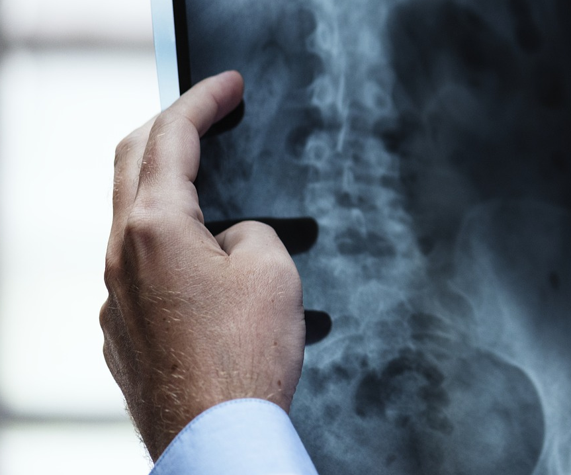
ASSESS MOBILITY VIA MEDICAL IMAGING
Academic Publication
Developed a protocol and algorithms to assess joints motion via medical imaging
2016

Slide 4
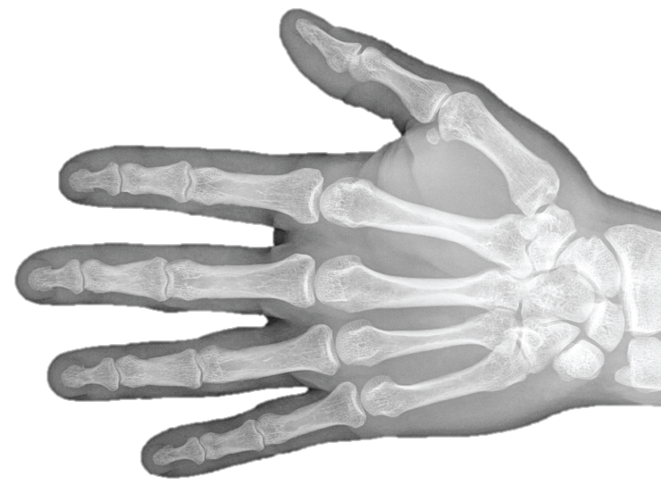
DYNAMIC MEDICAL IMAGING ACCURACY
Academic Publication
Assessed the accuracy of dynamic medical imaging to assess hand mobility
2016

Slide 5
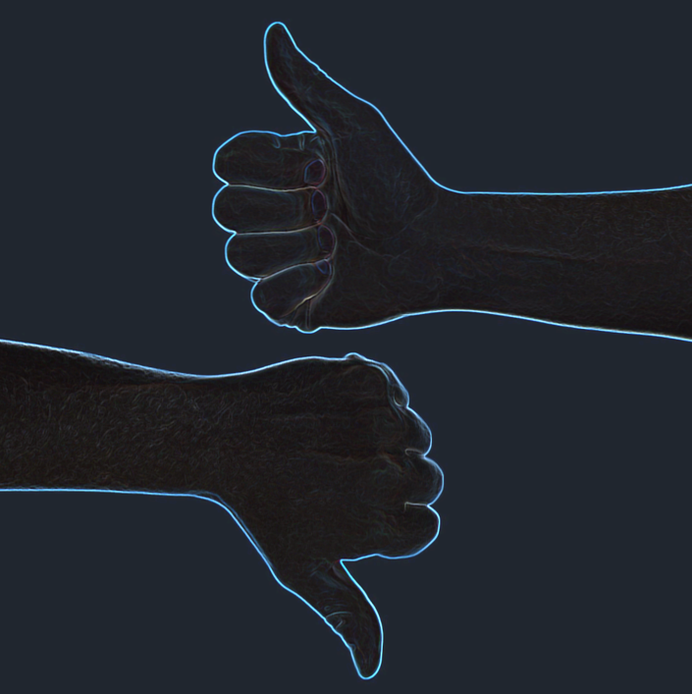
HEALTHY

Slide 6
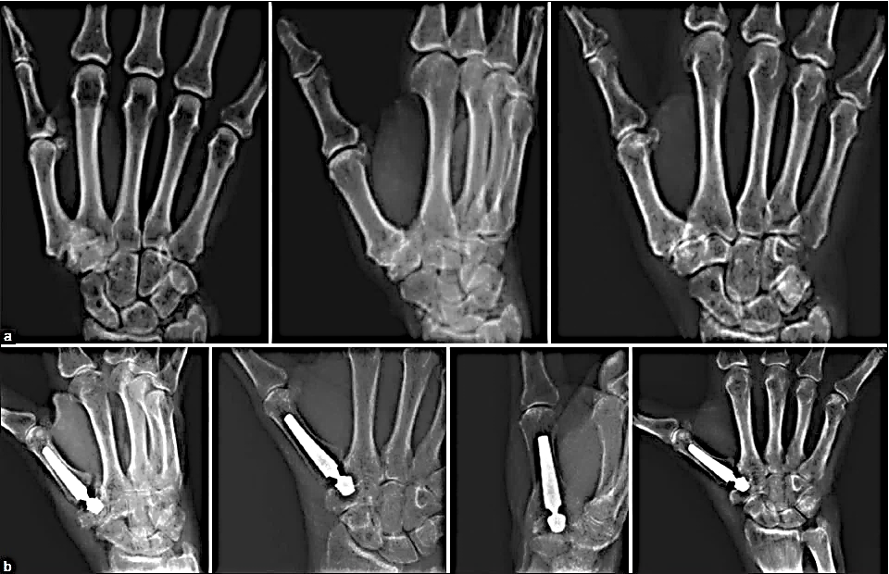
SURGICAL IMPLANTS AND MOBILITY
Academic
Assessing the impact of thumb replacement implants on hand mobility
2017

Slide 7
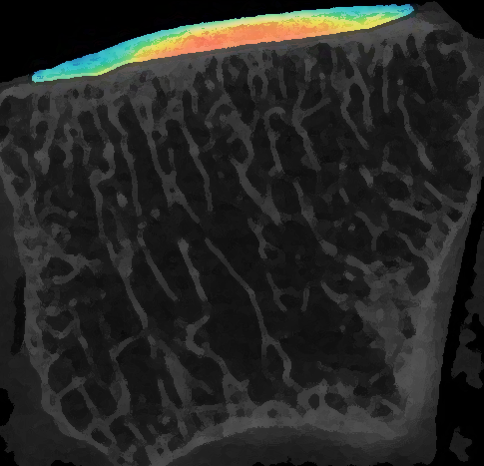
SOFT TISSUES PROPERTIES
Academic
Publication
Developed a protocol to assess soft tissues properties using medical imaging
2018

Slide 8

SIGNAL PROCESSING TOOLBOX
Algorithm Development
Designed algorithms to process and extract features from (bio)signals
2018

Slide 9
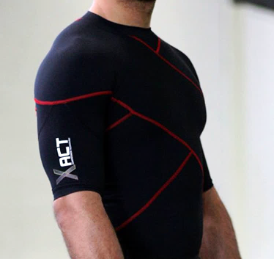
COMPRESSION GARMENTS
Industry Project
Measured the impact of compression garments on shoulder mobility
2018

Slide 10


FOOT PRESSURE SCAN TECHNOLOGIES
Industry Project
Compared the accuracy of different foot pressure mapping technologies
2018

Slide 11
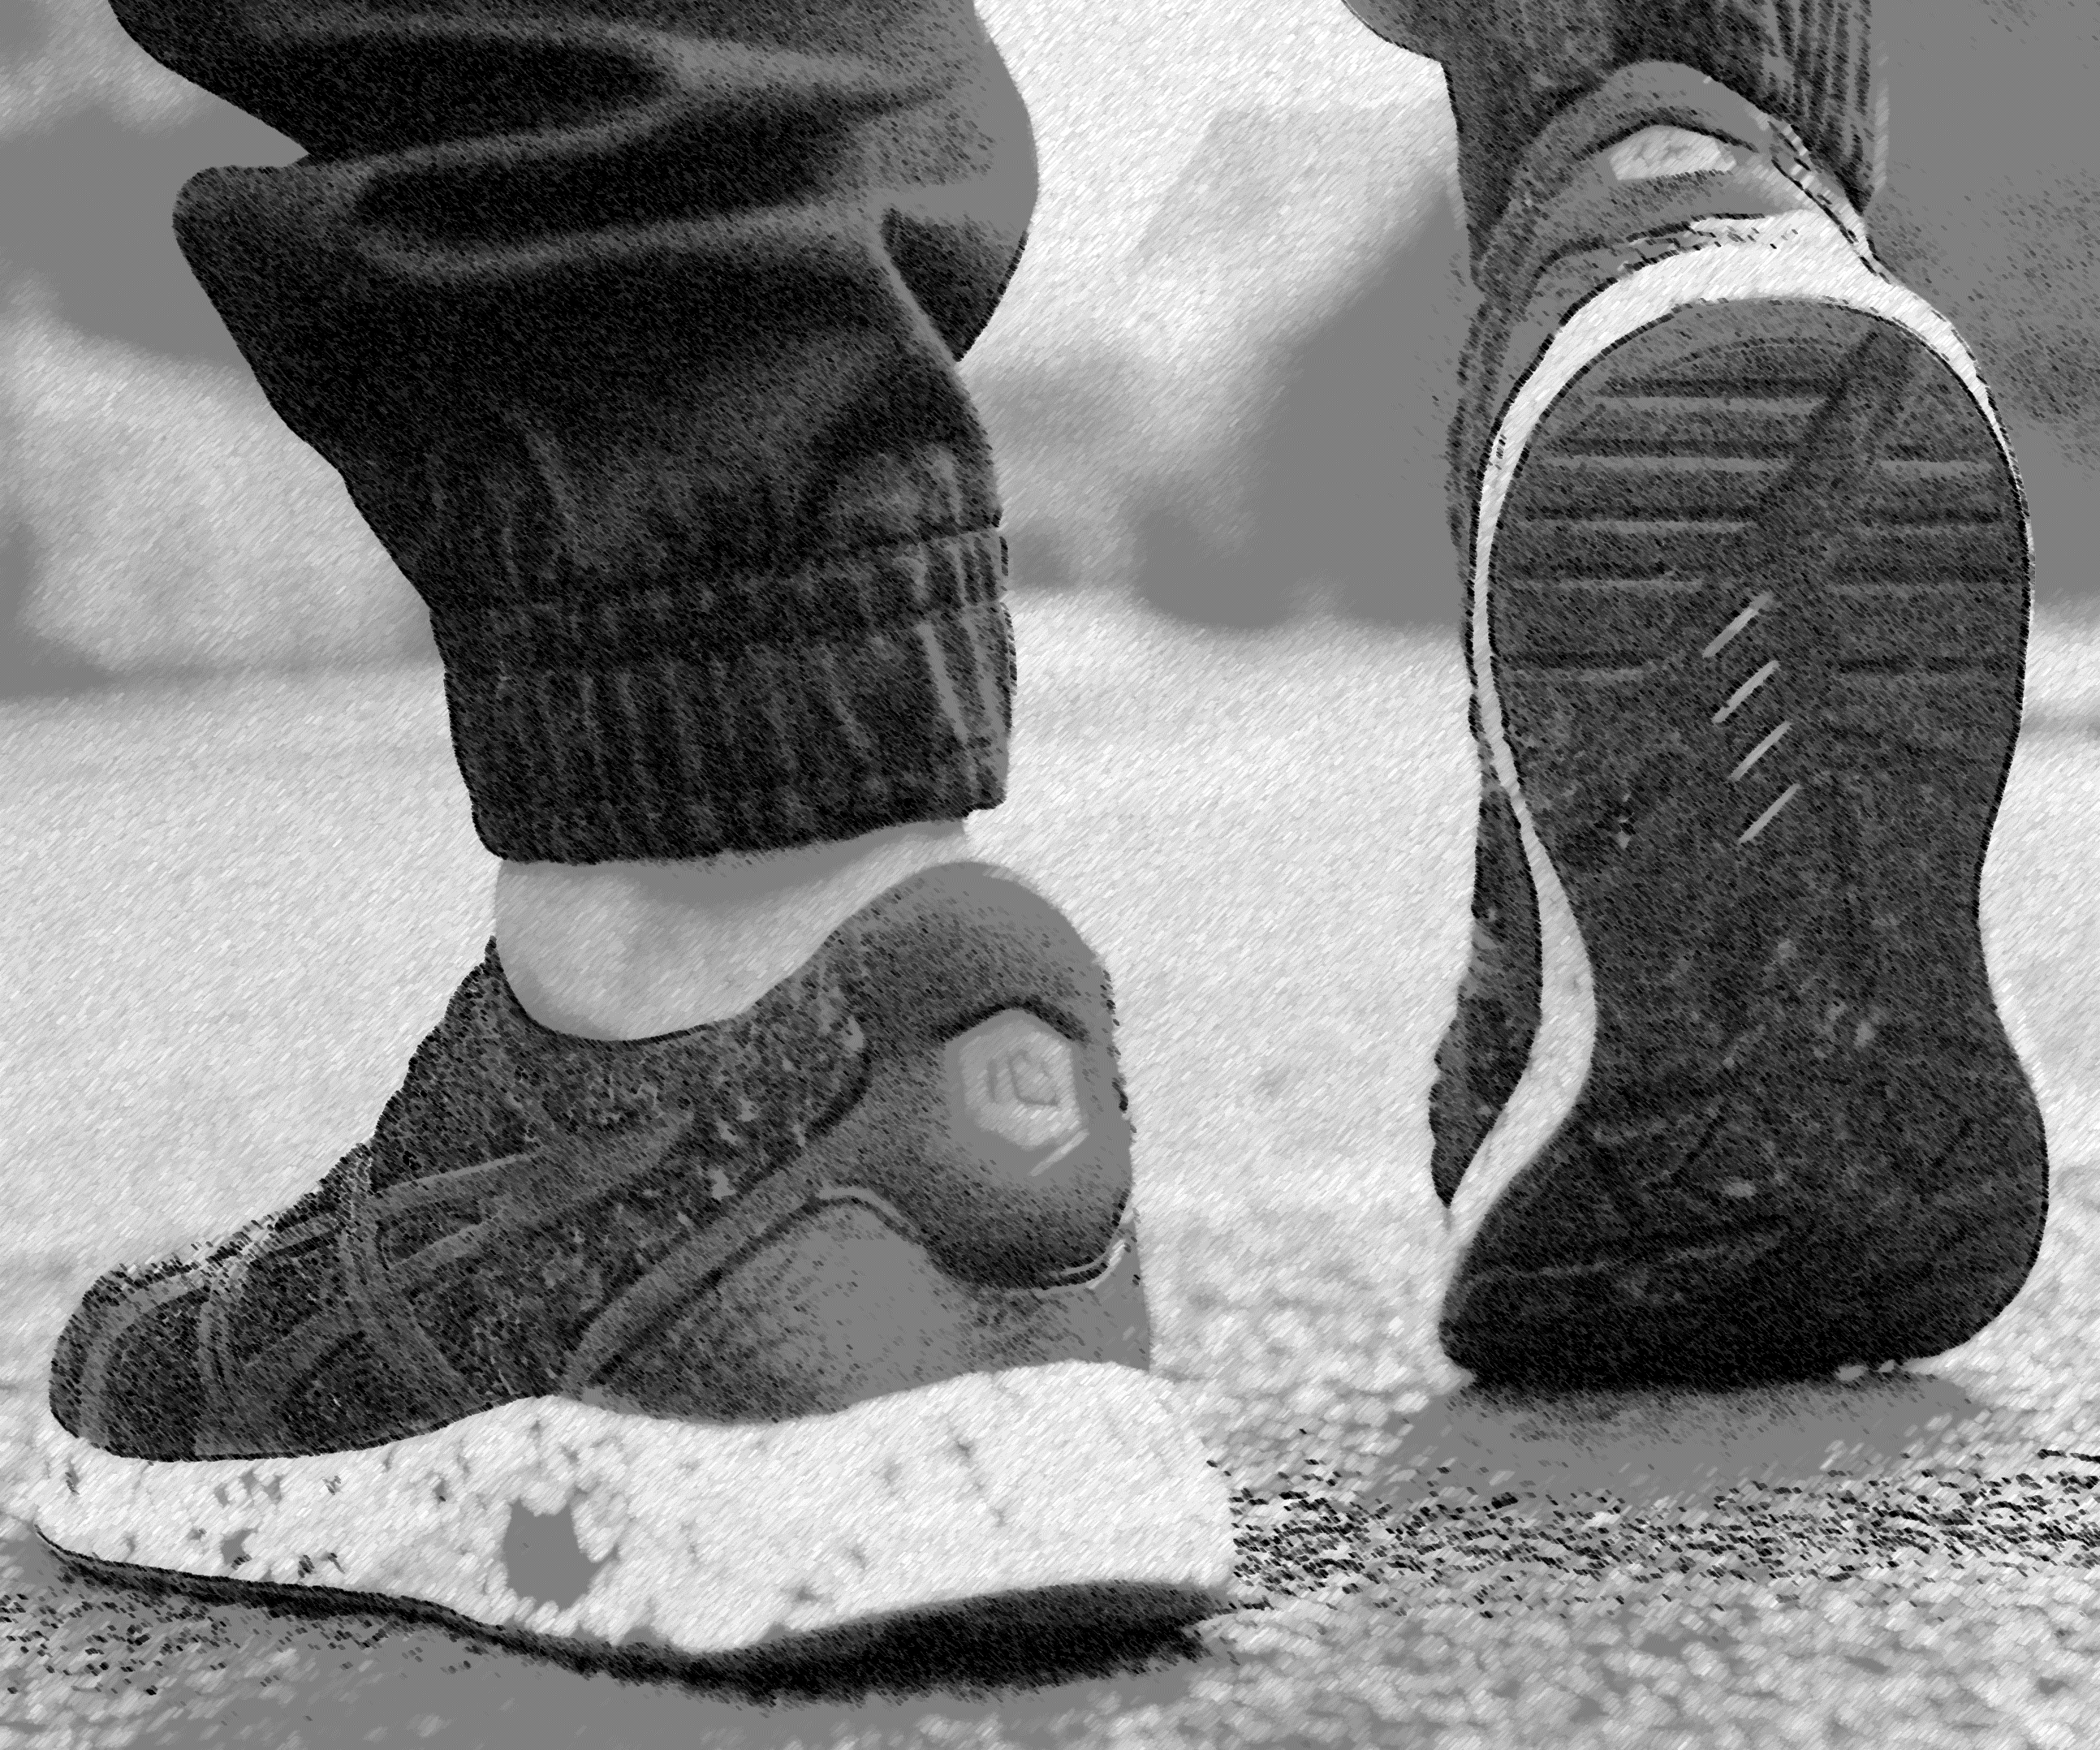
INSOLE IMPACT ON LOWER LIMBS
Industry Project
Measured the impact of new insole technology on lower limbs biomechanics
2018

Slide 12

Machine Learning

Slide 13

Computer Vision

Slide 14
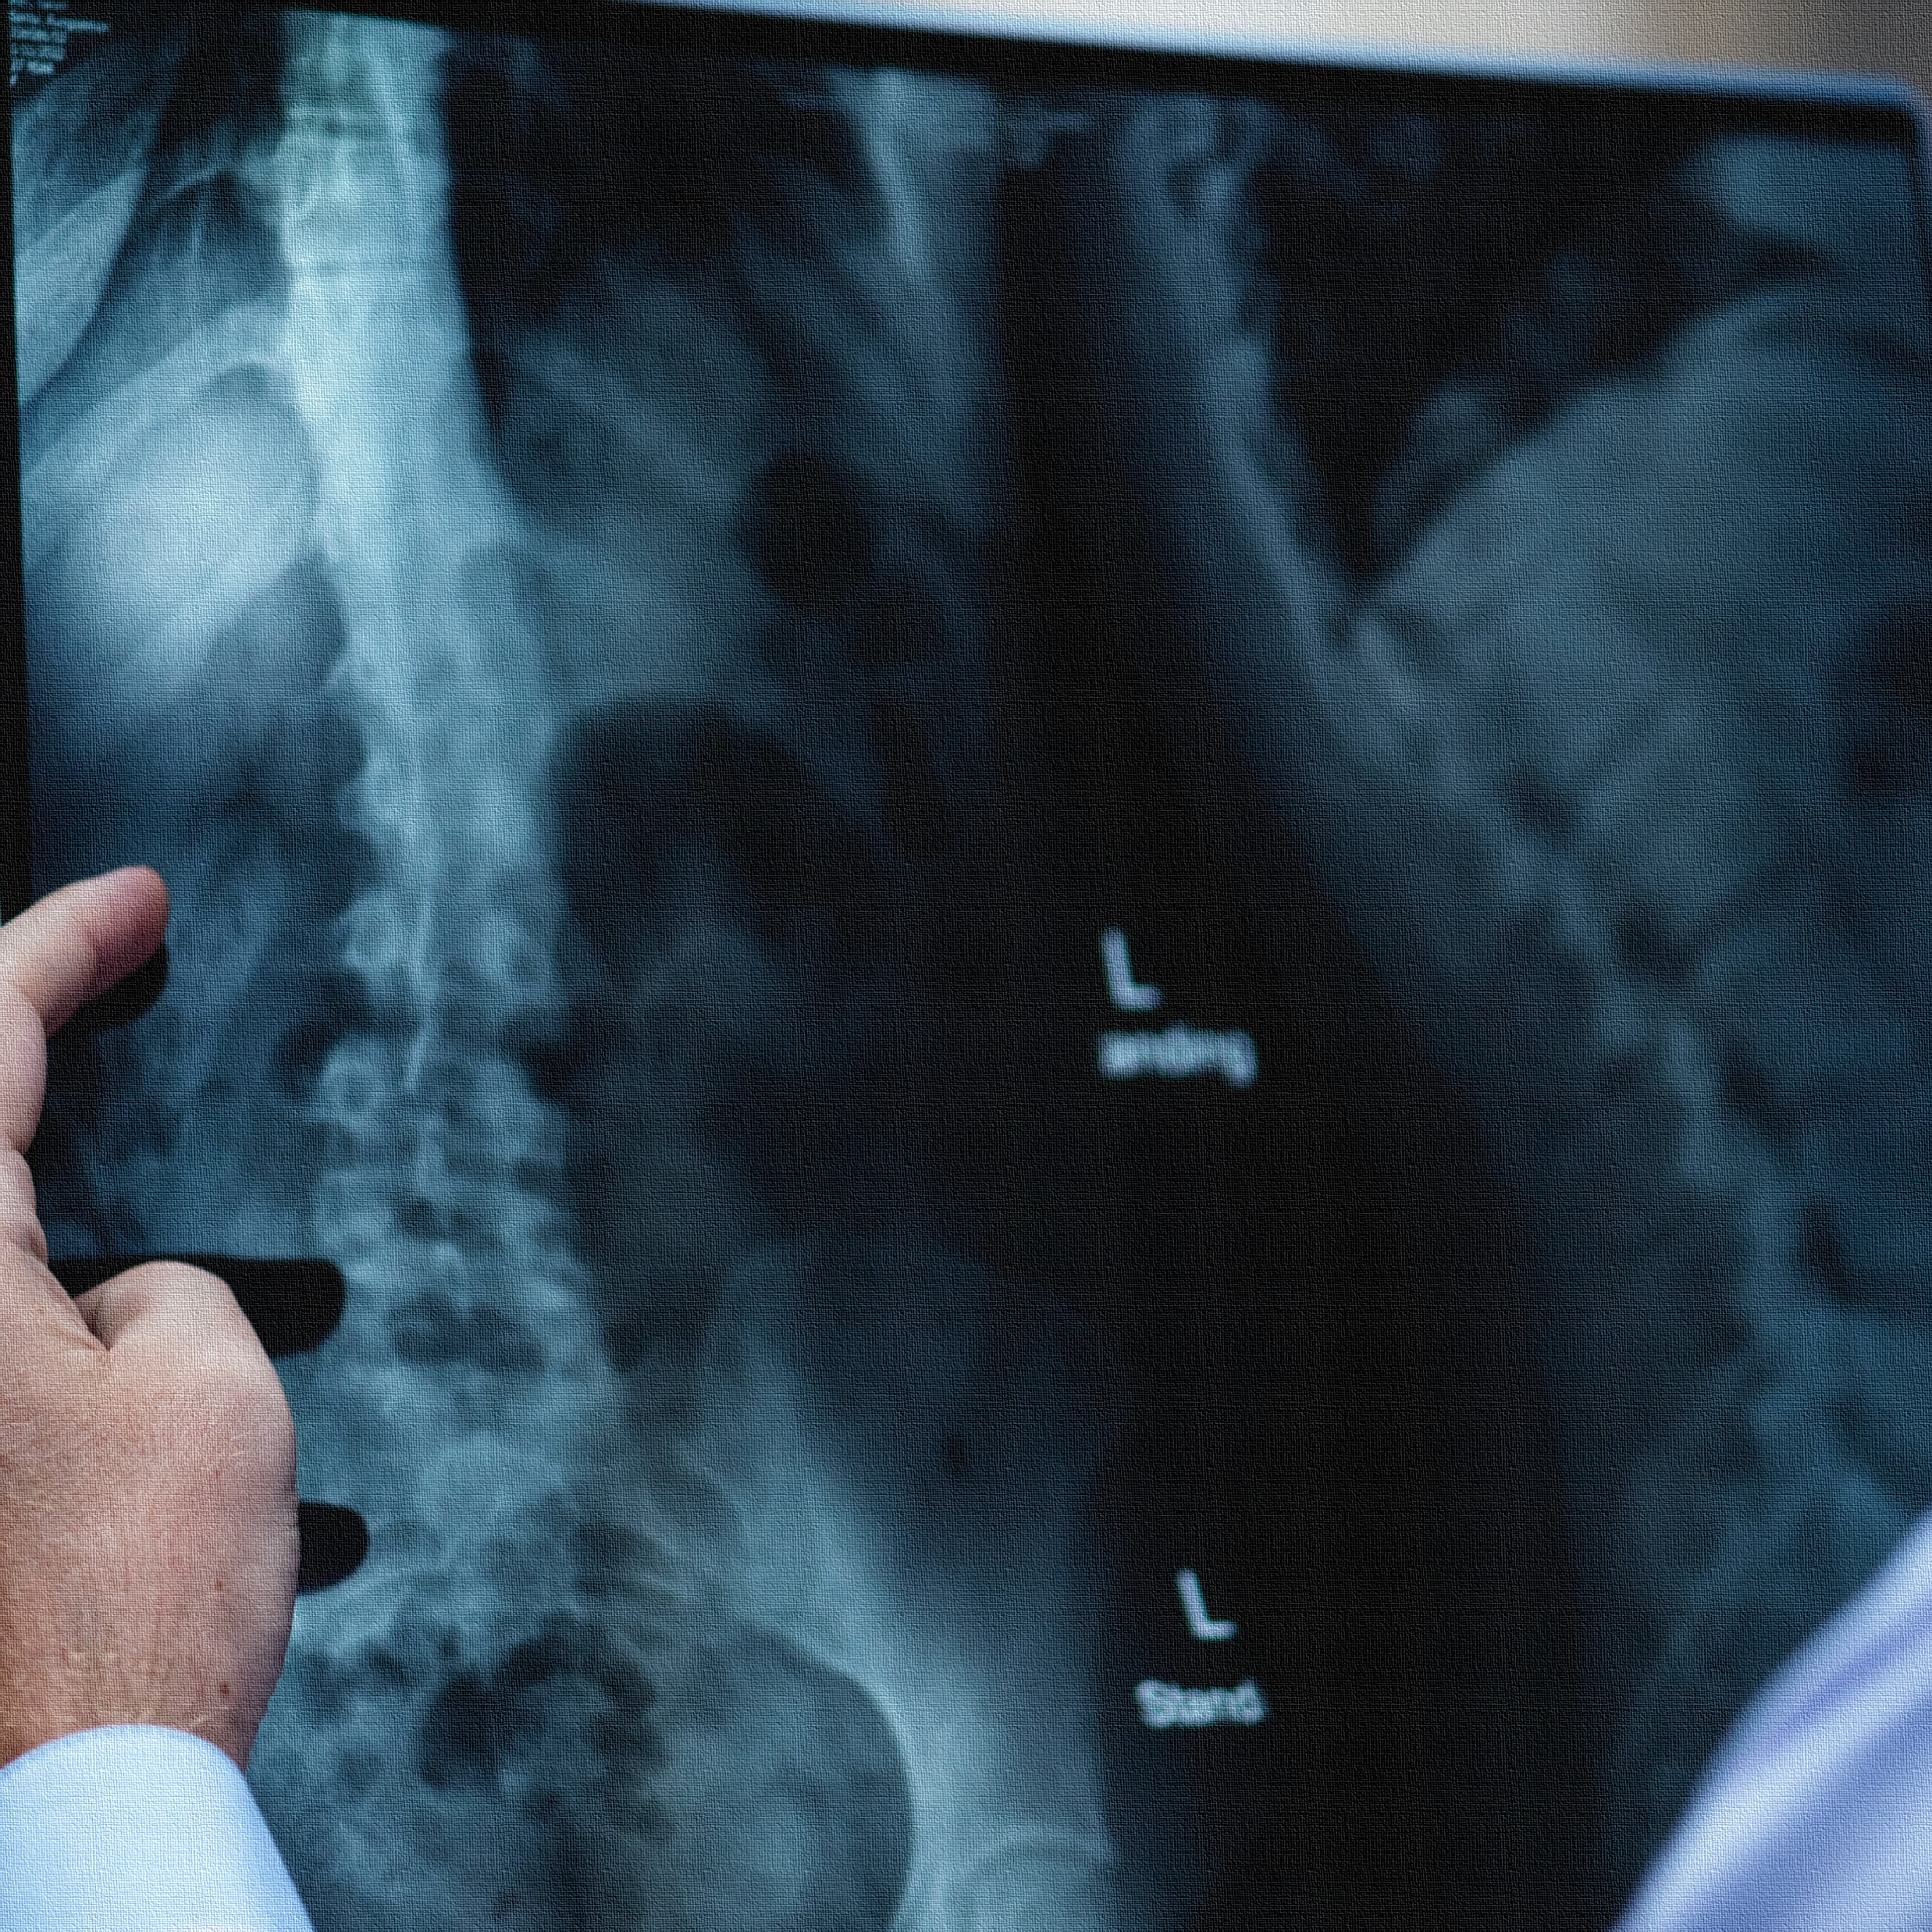
MEDICAL
IMAGING

Slide 15
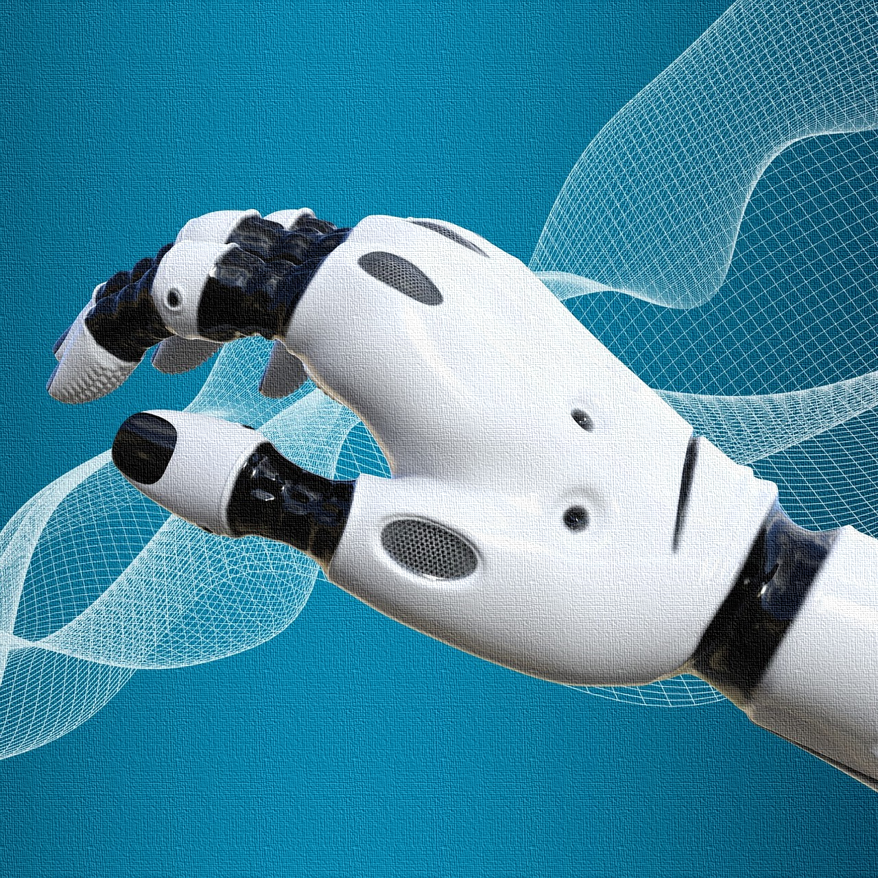
COMPUTER
MODELING

